Slide 1

Microsoft Certifications, these are the droids you are looking for!
aaronralls.com
@cajunAA
github.com/aaronralls
Arkeytek.com
Notes:
WIFI Coupon Code hampton1234 (lower case)
Photo by Jake weirick on Unsplash
Details
Stop wandering around the galaxy without a certification and come and learn why you need them! Aaron Ralls will guide you on your journey to unleashing your full potential as a technical professional. He will share his personal strategy for passing exams on the first attempt and on a limited budget. In this feature presentation, he will cover how he was able to pass 13 exams on the first attempt and most recently two in five hours!

Slide 2
What you will Learn
Why you should get certified
Certification types
What it’s like to take an exam
What to study for an exam
Practice exam sources
How to study for & take an exam

Slide 3

WHO Has taken a certification exam?
Notes:
http://legogenre.com/legogenre-wallpapers/

Slide 4
Why you should get certified
Exposure to New Things
Improve confidence
Improve Resume
new role opportunities
Badges!!!
Notes:
video

Slide 5

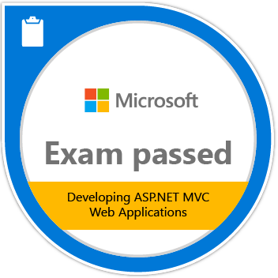
Why you should get certified
Notes:
video

Slide 6
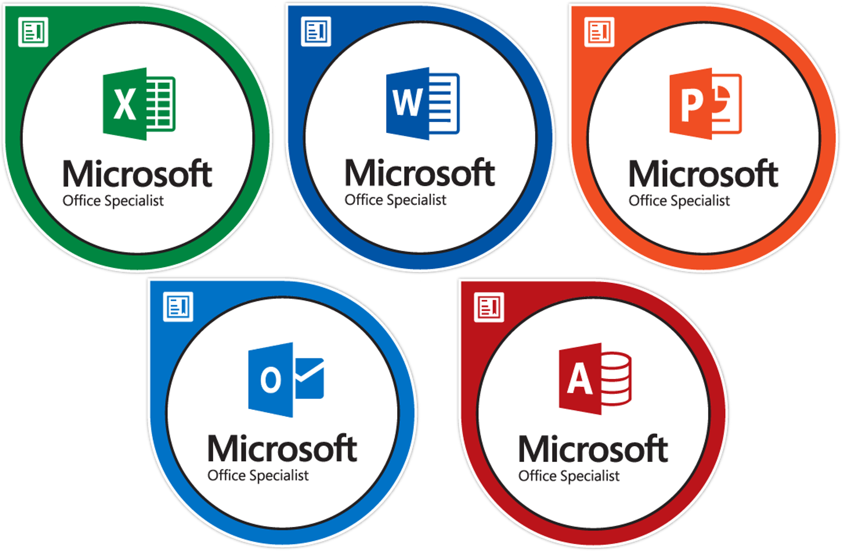
Certification Types
Notes:
MOS: Microsoft Office Specialist Certification
The lifetime benefit of Microsoft Office Specialist
Demonstrate that you have the skills needed to get the most out of Office by earning a Microsoft Office Specialist (MOS) certification in a specific Office program.

Slide 7
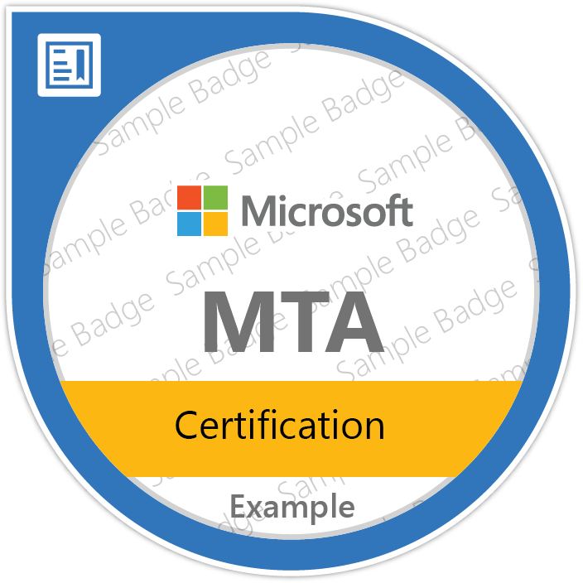
Certification Types
Notes:
MTA: Microsoft Technology Associate (better for recent college grads or people switching careers)
Fundamental technical knowledge
Microsoft Technology Associate is an entry-level certification intended for people seeking knowledge of fundamental technology concepts.
1 exam

Slide 8
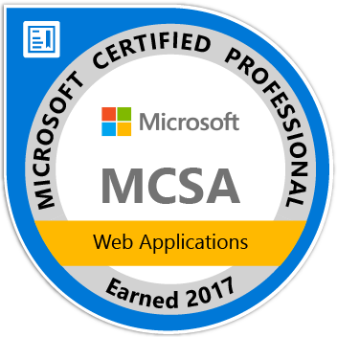
Certification Types
Notes:
MCSA: Microsoft Certified Solutions Associate (any level of job exp) (2 Exams)
Core skills for IT professionals and developers
Microsoft Certified Solutions Associate is intended for people who seek entry-level jobs in an information technology environment.
Diff categories for areas
Mobility
Windows 10
Cloud
Cloud
Linux on Azure
Windows Server 2016
Productivity
Office 365
Data
SQL Database Admin or Development
Machine Learning
BI Reporting
Data Engineering with Azure
App Builder
Windows
Web Apps
Business
Dynamics 365

Slide 9
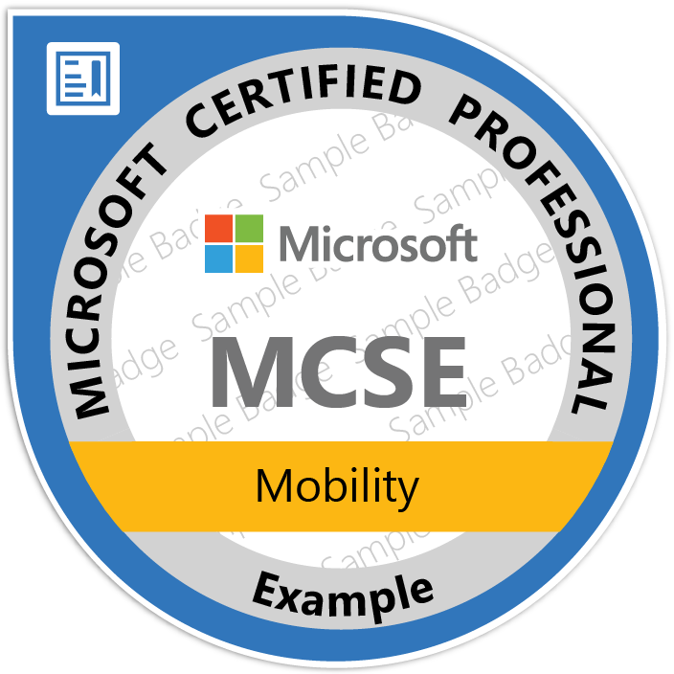

Certification Types
Notes:
MCSE: Microsoft Certified Solutions Expert
The globally recognized standard for IT Professionals
Microsoft Certified Solutions Expert is a certification intended for IT professionals seeking to demonstrate their ability to build innovative solutions across multiple technologies, both on-premises and in the cloud.
Mobility (1 exam)
Admin Microsoft System Center Configuration Manager
Manage devices in Enterprise
Deploying Windows Desktops and Enterprise Apps
Business (1 exam)
Data (1 exam)
Productivity (1 exam)
Exchange Server
Skype
Cloud (1 exam)

Slide 10
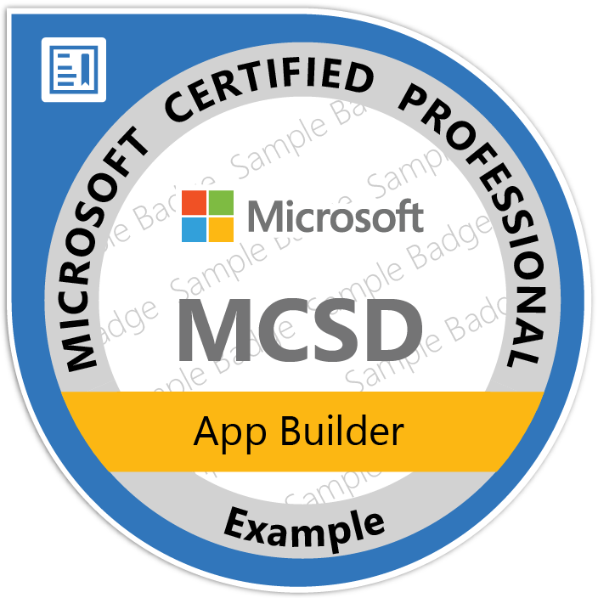
Certification Types
Notes:
MCSD: Microsoft Certified Solutions Developer
The globally recognized standard for IT Professionals
Microsoft Certified Solutions Expert is a certification intended for IT professionals seeking to demonstrate their ability to build innovative solutions across multiple technologies, both on-premises and in the cloud.
App Builder (1 exam)

Slide 11
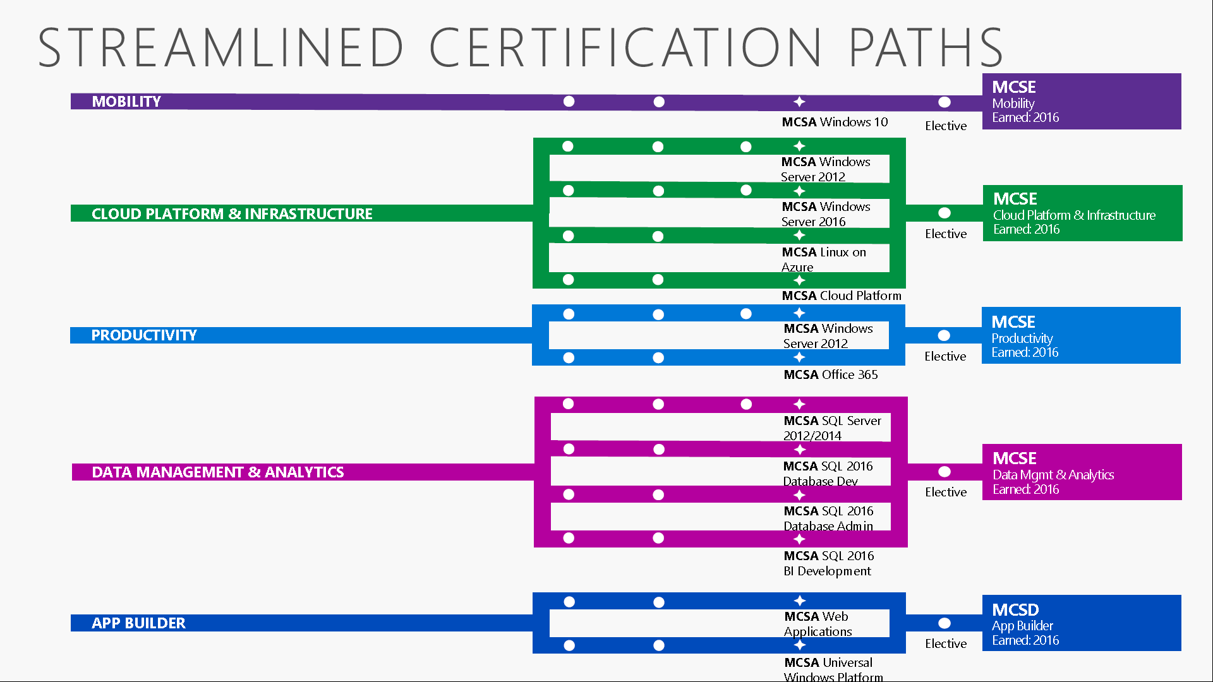
Certification Types
Notes:
MCSD: Microsoft Certified Solutions Developer
The globally recognized standard for IT Professionals
Microsoft Certified Solutions Expert is a certification intended for IT professionals seeking to demonstrate their ability to build innovative solutions across multiple technologies, both on-premises and in the cloud.
App Builder (1 exam)

Slide 12
What is it like to take an exam?

Slide 13
youtube.com/watch?v=LwF5WiMkBXo&t=4s
Notes:
https://www.youtube.com/watch?v=LwF5WiMkBXo&t=4s

Slide 14
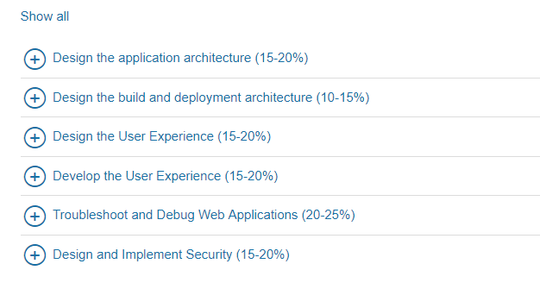
What to study for an exam?

Slide 15
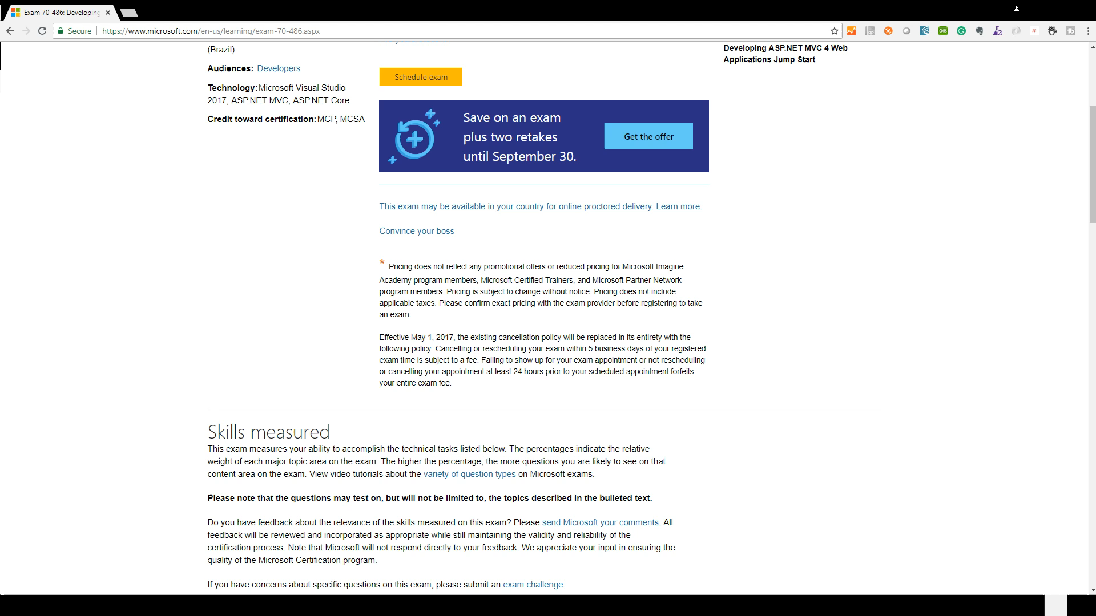
What to study for an exam?

Slide 16
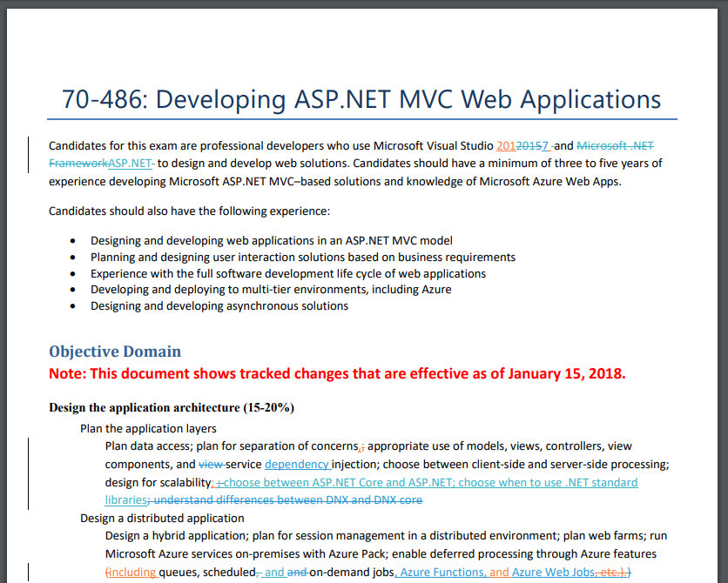
Notes:
Exam updates!

Slide 17
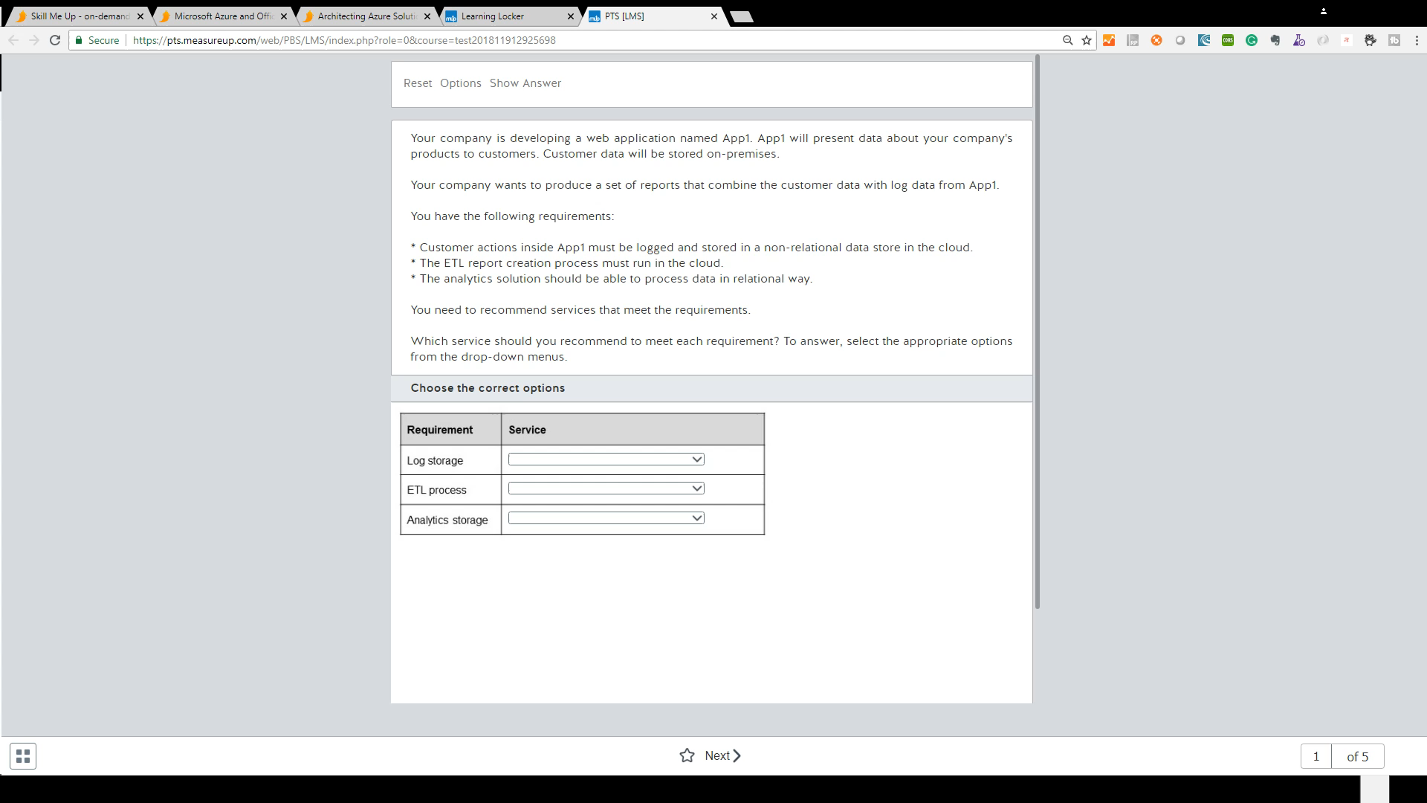
Practice exam sources

Slide 18
How to study for an exam
make a schedule
Use Practice exam to Assess current knowledge
Identity items you can use on a project

Slide 19
How to study for an exam
study in Order
Join FB Groups
follow Twitter accounts

Slide 20
How to study for an exam
docs.microsoft.com
EDX.ORG
mva.microsoft.com
PLuralsight

Slide 21
How to take an exam
Good Sleep
Plan an Exam Time for You
Get there Early
Refresh 10 min Before Exam
Identify Keywords in Q’S

Slide 22

Will you join me!

Slide 23

Questions
aaronralls.com
@cajunAA
github.com/aaronralls
Arkeytek.com

Slide 24

resources
measureup.com
skillmeup.com
facebook.com/groups/MS70486Cert
bit.ly/70-486Promo
microsoft.com/en-us/learning/certification-overview.aspx

